Slide 1

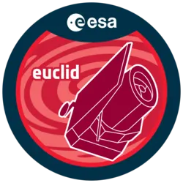

BENCHMARKING FOUNDATION MODELS FOR UNSUPERVISED DISCOVERY IN LARGE MULTIMODAL ASTROPHYSICAL DATASETS
Maxime RONCERAY(1) - Marc Huertas-Company(3)(4) - Alexandre Chanson(2) - Malgorzata Siudek(3) - Anna Preto(6)(11) - Julien Zoubian(7) (8) - Michael J.Smith (5) - Clara Bonini (8)(9)(10)
+ AstroINFO Collaboration
(1) Université de Tours - (2)LIFAT - (3)Instituto de Astrofísica de Canarias -(4) Institut d’Astrophysique de Paris - (5)Harvard - (6)Astroparticule et Cosmologie - (7)CPPM - (8)Aix Marseille Univ - (9)CNES - (10)LAM - (11)Mews Labs
Blois - 12 février 2026

Slide 2
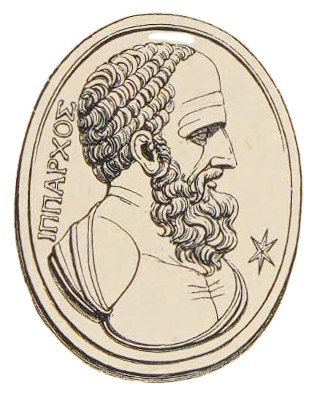
Astronomy
Around 150 BC Hipparchus* cataloged over 850 celestial objects
Astronomy relies on conducting and cataloging many observation to latter analyse
→ A “data dependant” field
*Hipparque

Slide 3

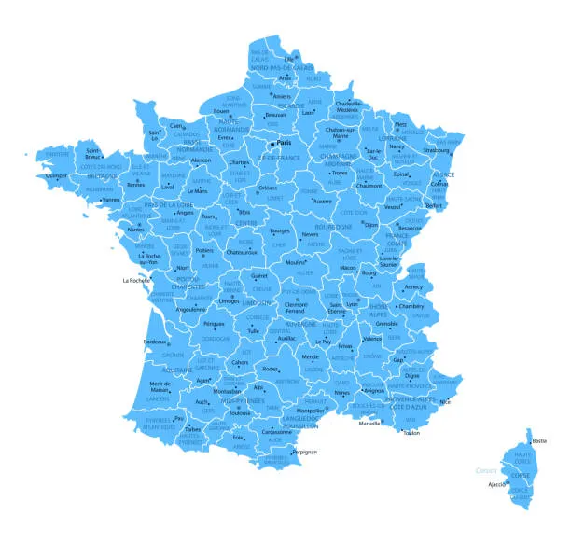


About Me
Euclid Summer school picture
Physics background + Computer Science Bachelor
Data Science Master’s Degree
Intern at CEA - FRANCE

Slide 4
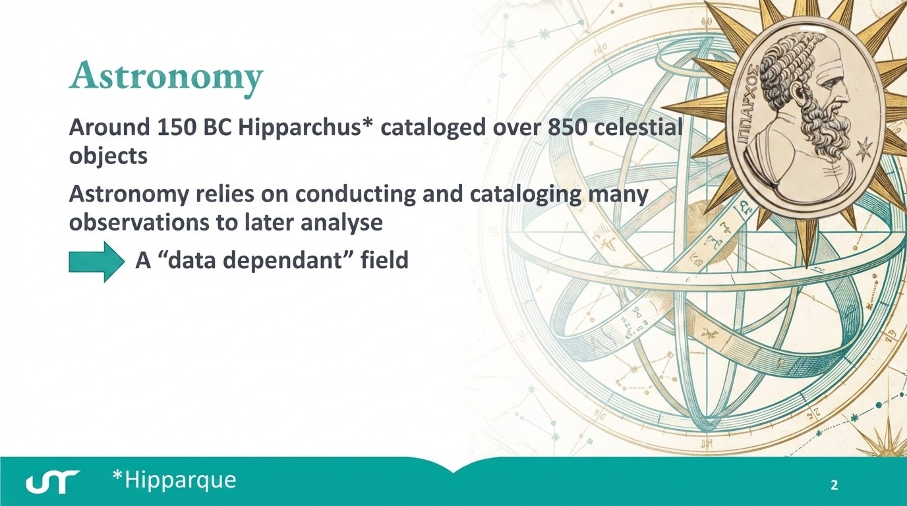

Slide 5
Plan for today
Astronomy: A Data-Dependant Field
Data & Missions: Euclid, DESI, and the Multimodal Universe
Anomalies and Anomaly Detection
Foundation Models
Methodology: Normalizing Flows
Results : Cross-Model Agreement, downstream tasks
Discussion & Perspectives
Introduction
Methods
Conclusion

Slide 6

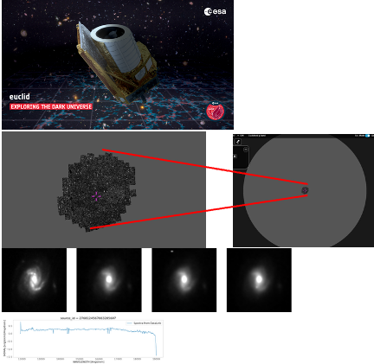
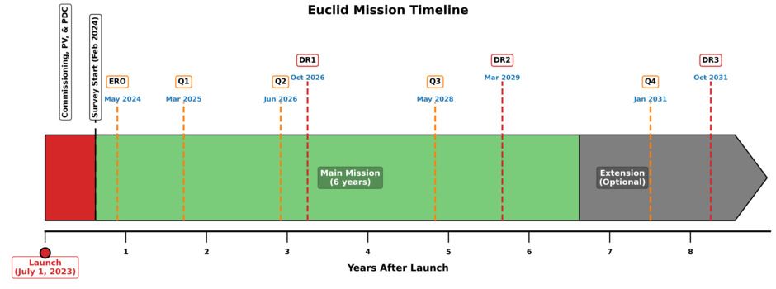
The Euclid Mission
Around 150 BC Hipparchus cataloged over 850 celestial objects
Astronomy is a data-driven science that builds understanding from large, well-calibrated surveys
ESA mission (2025) to map the dark Universe (Find Dark Matter Origin)
Instruments: Visual and Near infrared imaging
Q1 = first public data release (63 deg², 30M sources)

Slide 7
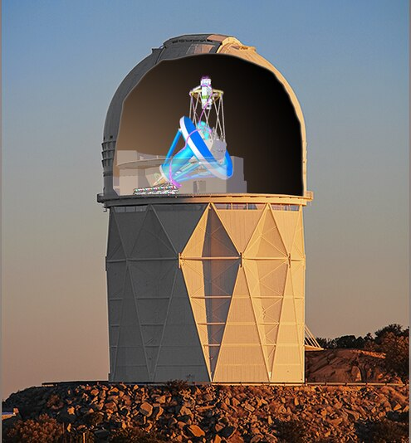
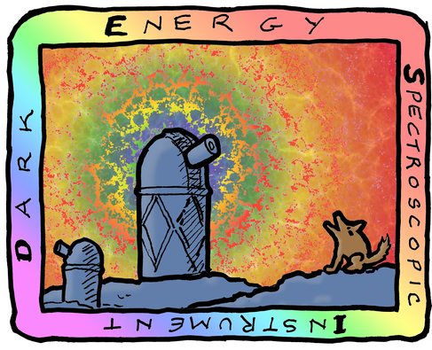
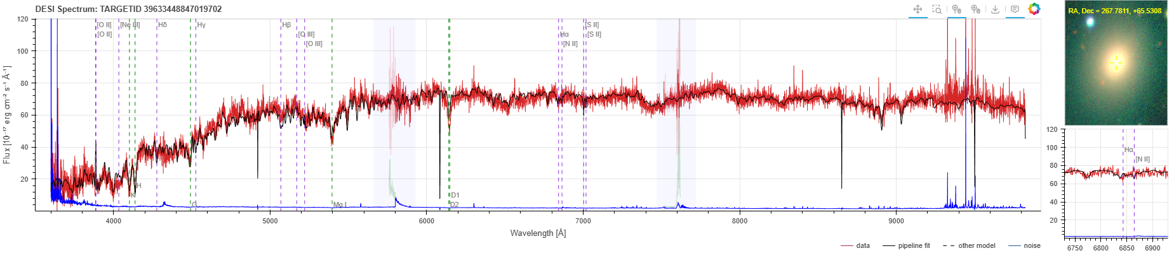
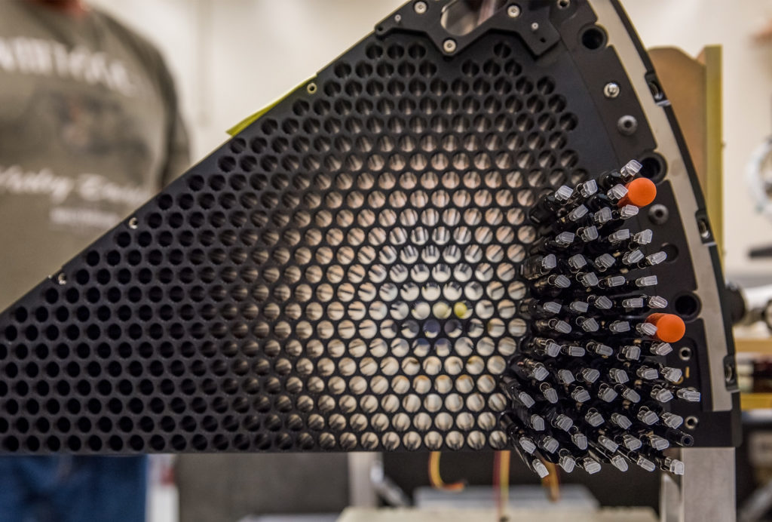
The DESI Mission
Dark Energy Spectroscopic Instrument
3-degree-diameter field of view that feeds a focal plate containing 5,000 robotic positioners.
Produce high quality spectra

Slide 8
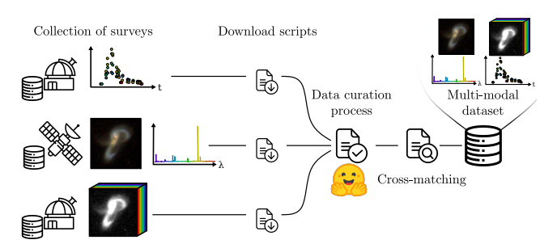
Multimodal universe
The Multimodal Universe: Enabling Large-Scale Machine Learning with 100TB of Astronomical Scientific Data https://arxiv.org/abs/2412.02527
huggingface.co/MultimodalUniverse

Slide 9
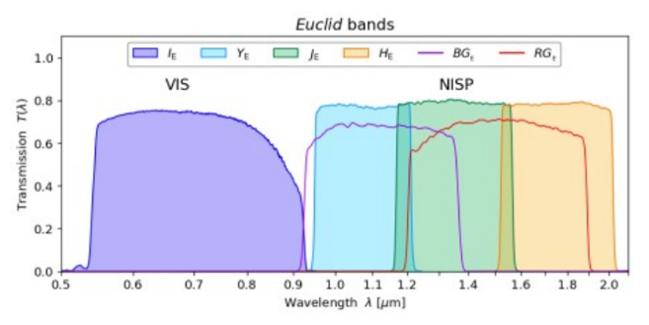
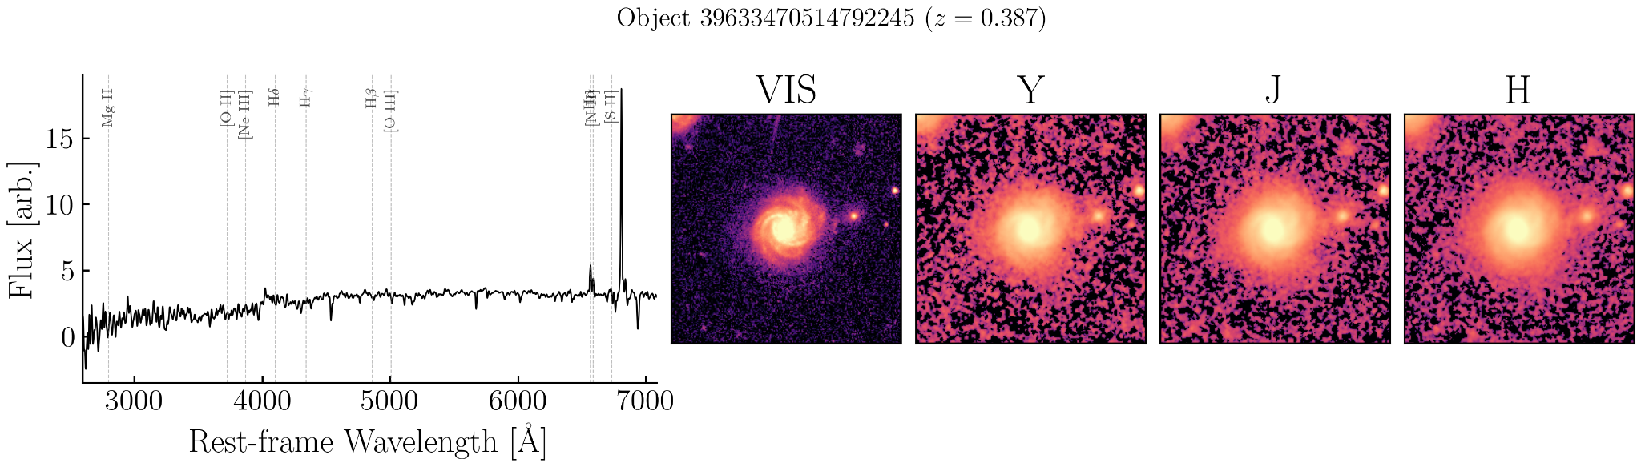

Data Sample
DESI Spectra
Euclid Images
https://huggingface.co/datasets/msiudek/astroPT_euclid_Q1_desi_dr1_dataset

Slide 10
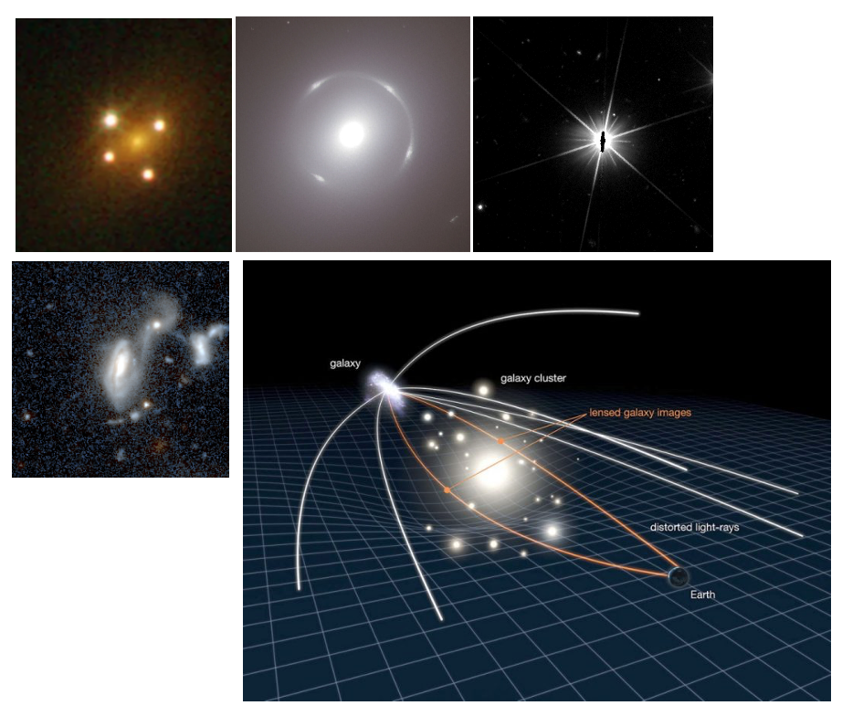
Anomalies
Astrophysical
(a)
(d)
Strong gravitational lenses (a)
  Multiple images or arcs of a background source caused by massive objects bending light
Unusual morphologies
  Galaxy Mergers (b)
  Rings
  jellyfish galaxies
  Active galactic nuclei
Instrumental artefacts (d)
  not useful but should appear out of distribution
(b)
(a)
Artefacts

Slide 11
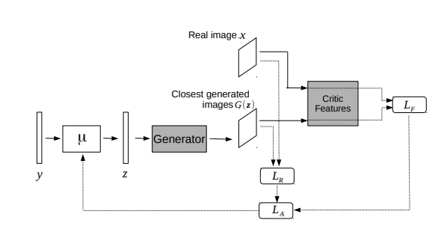
Anomaly detection
Anomaly detection → classic unsupervised problem
Classic methods
  Isolation forest, One class SVM …
Neural net based
  VAE trained on real and simulated data (https://arxiv.org/pdf/2003.08263)
Rely on tabular handcrafted features
Need retraining or supervision

Slide 12
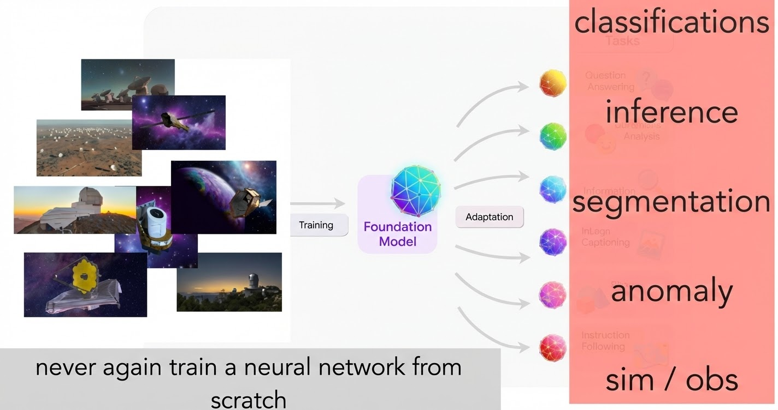
Foundation models
Large pre trained (self-supervised) models
Nowadays mostly transformers
Usable for downstream tasks with minimal adaptations
https://www.researchgate.net/figure/Large-language-models-LLMs-are-deep-learning-foundations-used-in-natural-language_fig1_380493580

Slide 13
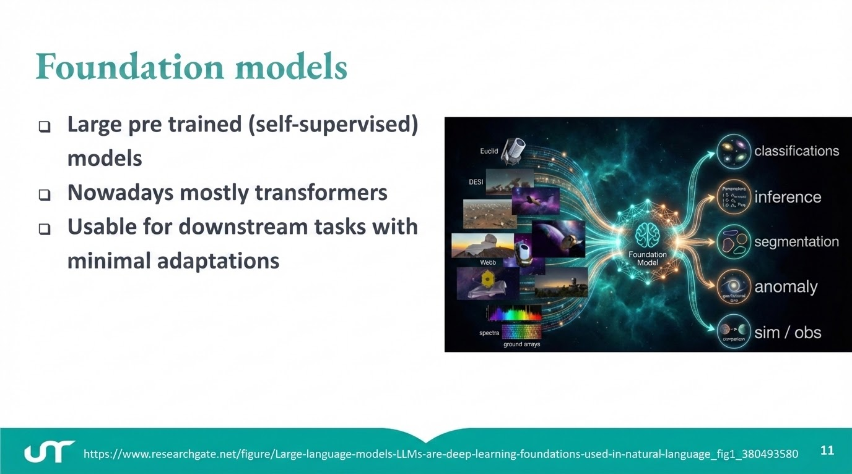

Slide 14
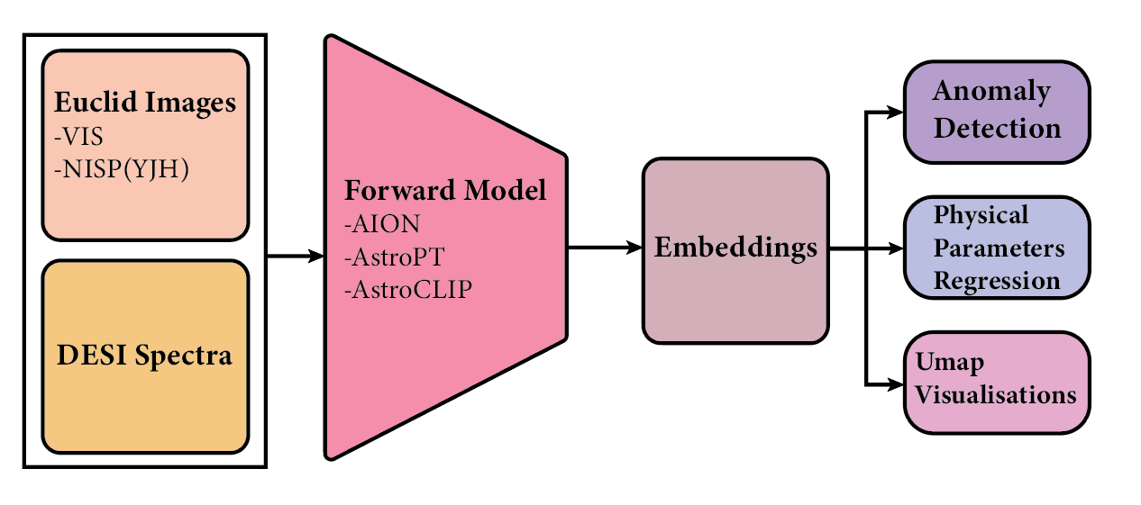
Foundation models
Embedding encodes meaningful properties and can be used

Slide 15
Research questions
BENCHMARKING FOUNDATION MODELS FOR UNSUPERVISED DISCOVERY IN LARGE MULTIMODAL ASTROPHYSICAL DATASETS
Does multimodality affect anomaly discovery ?
Do different foundation models agree on which objects are anomalous ?
Do embeddings that are effective for anomaly detection also encode known physical parameters in a structured and usable way ?

Slide 16
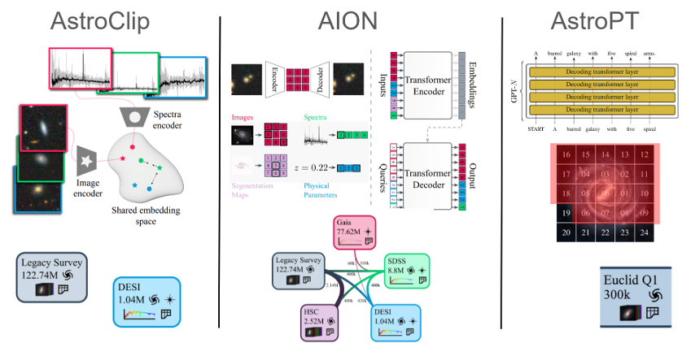
Astronomical Foundation Models
Embedding extracted from different models (AstroPT is GPT like)
Multimodal autoregressive transformer
Contrastive
Multimodal Transformer

Slide 17
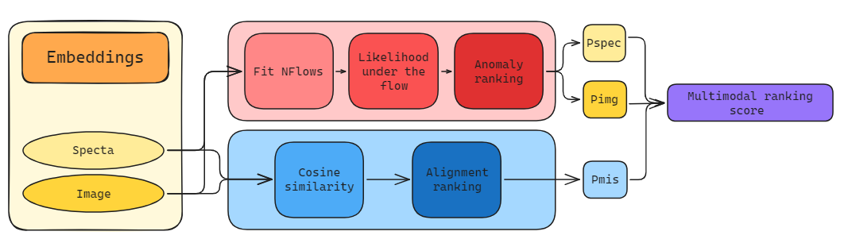
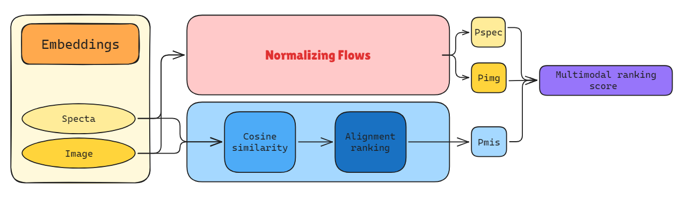
Anomaly detection pipeline

Slide 18
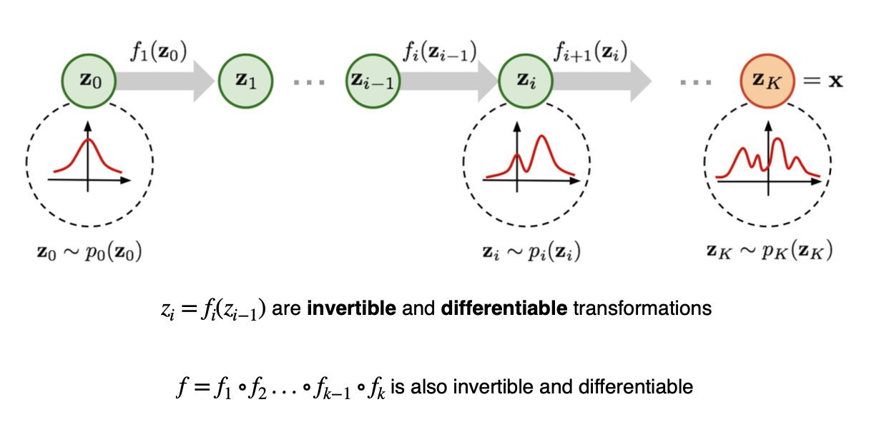
Normalizing flows
Tool to learn a distribution from a sample
Series of invertible transformation
  Starts from basic distribution (i.e. normal)
  Build “layer by layer” towards a complex distribution

Slide 19







NFs for Anomaly detection
Maximize the (exact) log-likelihood of the observed data under the model
1 : Forward an embedding observed x to the model to get z
In reality, we apply each learned transformations
2. Compute log density in the base distribution
Because Z is gaussian
3. Correct by the Jacobian (change of volume)
= convert “density per unit of volume in z to density per unit of volume in x”
4. Compute for X layer by layer
5. Anomaly Score
We need to find a transformation invertible and differentiable
6. Normalize
Notes:
En pratique on a souvent plusieurs couches de transformations, donc la log-vraisemblance totale, c’est log⁡pZ(z)\log p_Z(z)logpZ​(z) plus la somme des log-déterminants de chaque couche.

Slide 20
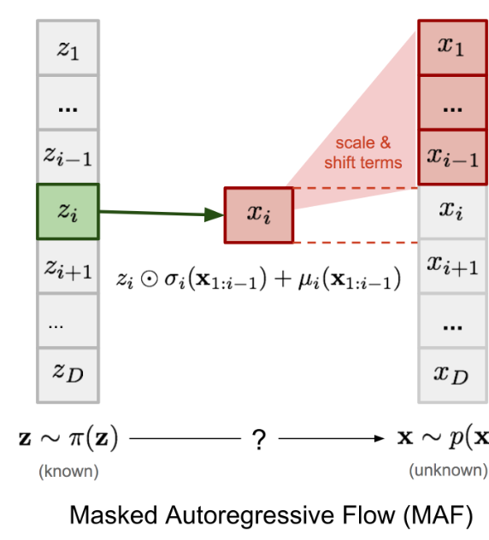
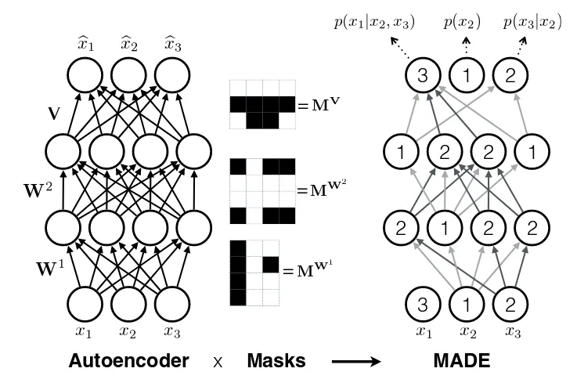
Masked Autoregressive Flows
Each variable is modelled conditionally on the previous ones
Element-wise transformation
Each variable is modelled conditionally on
μ and σ are predicted by a masked neural network
Causal masking (MADE)
Ensures that depends only on
Cause the Jacobian to be lower triangular
Obtain an anomaly ranking of each objects in the embeddings
Notes:
Ici je présente les Masked Autoregressive Flows, ou MAF. L’idée centrale, c’est de modéliser un vecteur xxx de façon autoregressive : chaque composante xix_ixi​ est modélisée conditionnellement aux précédentes x<ix_{<i}x<i​
Concrètement, on fait une transformation élément par élément. Pour chaque dimension iii, on part d’une variable latente ziz_izi​ — typiquement gaussienne — et on fabrique xix_ixi​ via une transformation affine :
Le point important, c’est que μi\mu_iμi​ et σi\sigma_iσi​ ne sont pas des constantes : elles sont prédites par un réseau de neurones, mais un réseau “masqué”.
Le masquage causal, c’est exactement MADE : on applique des masques sur les matrices de poids pour garantir que la sortie associée à la dimension iii ne dépend que de x1,…,xi−1x_1,\dots,x_{i-1}x1​,…,xi−1​, jamais de xix_ixi​ ou des futures.
Résultat : côté apprentissage, c’est très efficace parce qu’on a une vraisemblance exacte et différentiable. On évite une approximation variationnelle comme dans les VAE.
En revanche, pour générer des échantillons, c’est plus lent : on doit produire x1x_1x1​, puis x2x_2x2​, etc., de manière séquentielle. C’est le coût de l’autoregressivité.

Slide 21
Anomaly detection pipeline

Slide 22
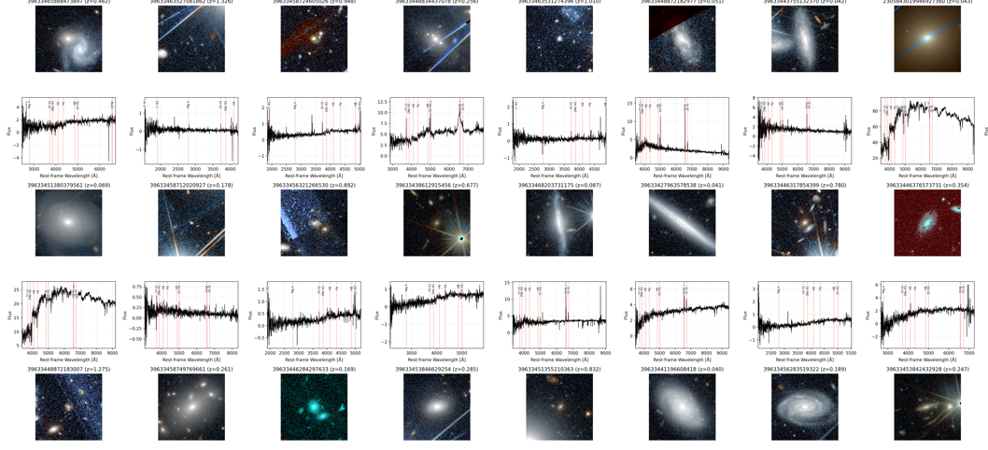
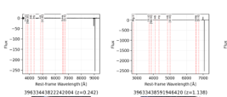
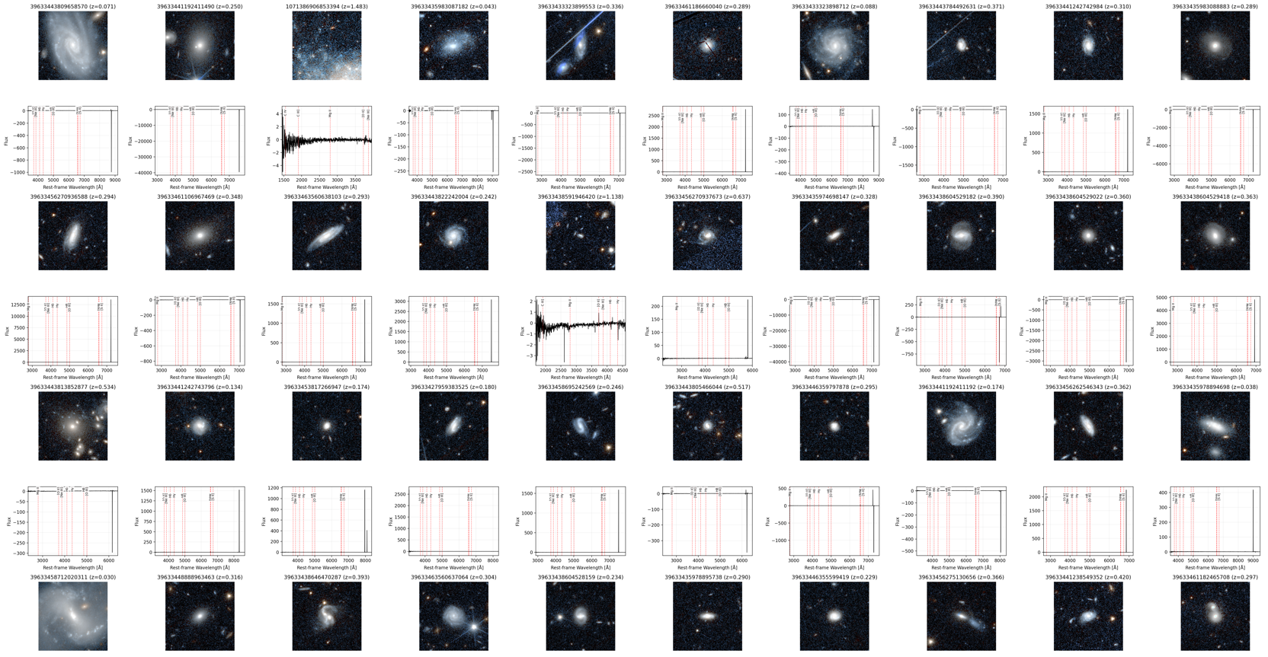


Unimodal Results
Unimodal anomalies
Dominated by weird spectrums
Dominated by instrumental artifacts
Notes:
Observed anomaly patterns. Visual inspection reveals a small number of recurring qualitative
patterns. The categories below are descriptive summaries of commonly observed behaviors, rather
than a strict or exhaustive classification.
AGN-like spectral outliers. Several candidates exhibit broad or asymmetric emission lines that de-
viate strongly from the bulk of the DESI sample. These rare spectral signatures are primarily high-
lighted by spectrum-based anomaly scores.
Strong gravitational lens candidates. Some high-ranking anomalies display arc-like or ring-like
morphologies in Euclid imaging, combined with spectra that are difficult to interpret as a single
galaxy. These systems are typically emphasized by multimodal embeddings, suggesting a genuinely
cross-modal anomaly signal
Post-starburst and quiescent galaxies. A subset of image-driven anomalies corresponds to smooth,
early-type morphologies whose spectra show strong Balmer absorption and weak or absent emission
lines, consistent with rare or transitional evolutionary states.
Instrumental or processing artefacts. Diffraction spikes, saturation effects, ghosts, and residual im-
age defects are frequently detected as strong image-only outliers. While not of direct astrophysical
interest, these cases serve as a useful control, illustrating how multimodal information can down-
weight purely instrumental anomalies.

Slide 23
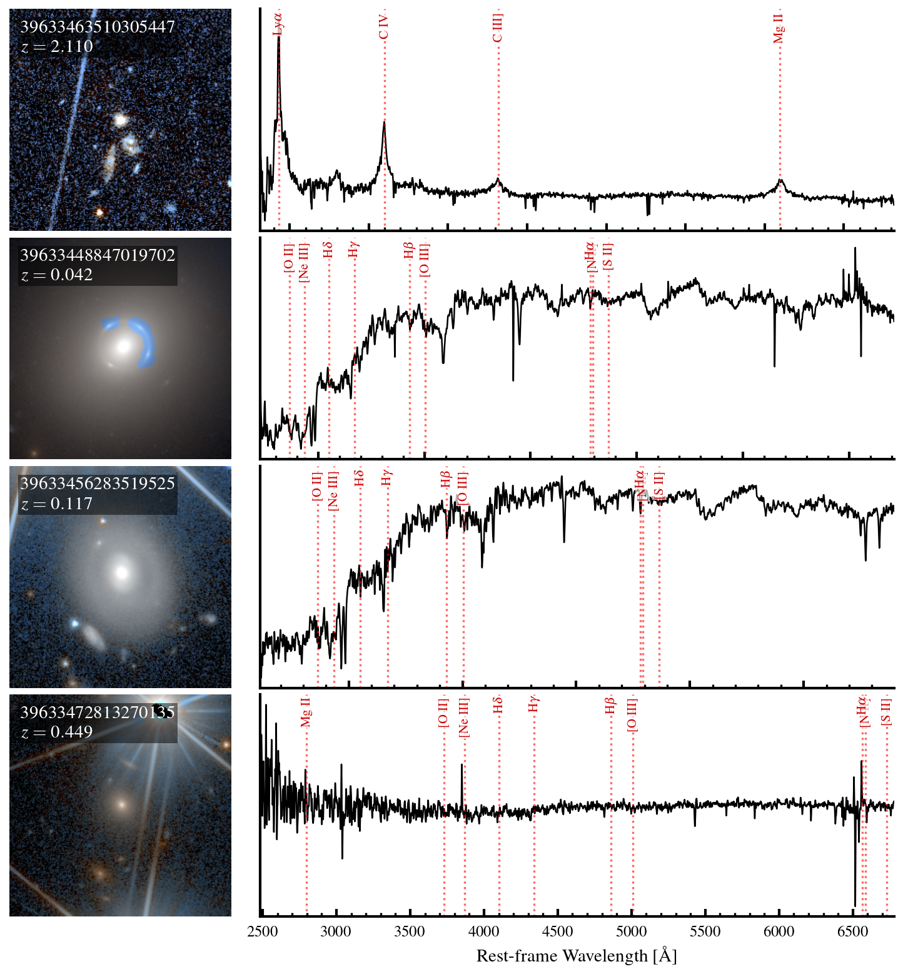

Multimodal Results
AGN-like
broad emission lines
Strong gravitational lens candidates.
arc-like or ring-like morphologies
Sample from the top 50 anomalies
Post-starburst and quiescent galaxies.
smooth, early-type morphologies
strong Balmer absorption and/or absent emission lines
Instrumental or processing artefacts.
Diffraction spikes
saturation effects
ghosts
residual image
Notes:
Observed anomaly patterns. Visual inspection reveals a small number of recurring qualitative
patterns. The categories below are descriptive summaries of commonly observed behaviors, rather
than a strict or exhaustive classification.
AGN-like spectral outliers. Several candidates exhibit broad or asymmetric emission lines that de-
viate strongly from the bulk of the DESI sample. These rare spectral signatures are primarily high-
lighted by spectrum-based anomaly scores.
Strong gravitational lens candidates. Some high-ranking anomalies display arc-like or ring-like
morphologies in Euclid imaging, combined with spectra that are difficult to interpret as a single
galaxy. These systems are typically emphasized by multimodal embeddings, suggesting a genuinely
cross-modal anomaly signal
Post-starburst and quiescent galaxies. A subset of image-driven anomalies corresponds to smooth,
early-type morphologies whose spectra show strong Balmer absorption and weak or absent emission
lines, consistent with rare or transitional evolutionary states.
Instrumental or processing artefacts. Diffraction spikes, saturation effects, ghosts, and residual im-
age defects are frequently detected as strong image-only outliers. While not of direct astrophysical
interest, these cases serve as a useful control, illustrating how multimodal information can down-
weight purely instrumental anomalies.

Slide 24
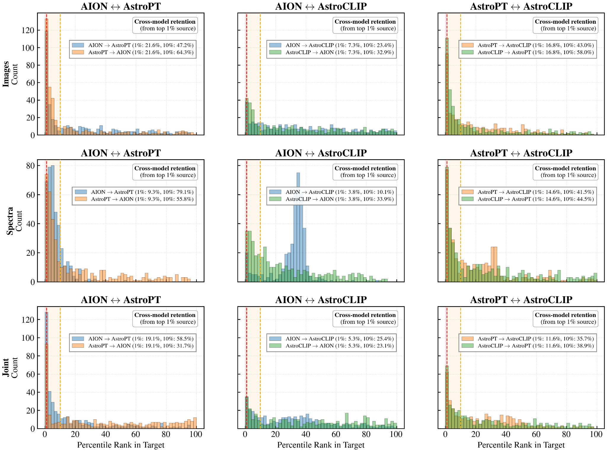

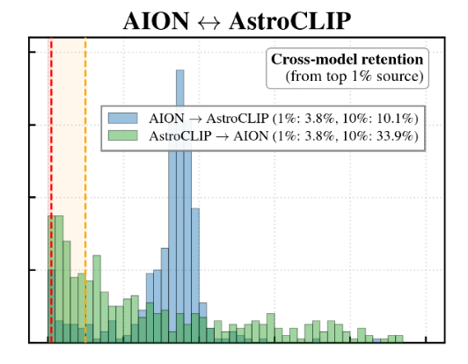
Results : cross model agreement

Slide 25
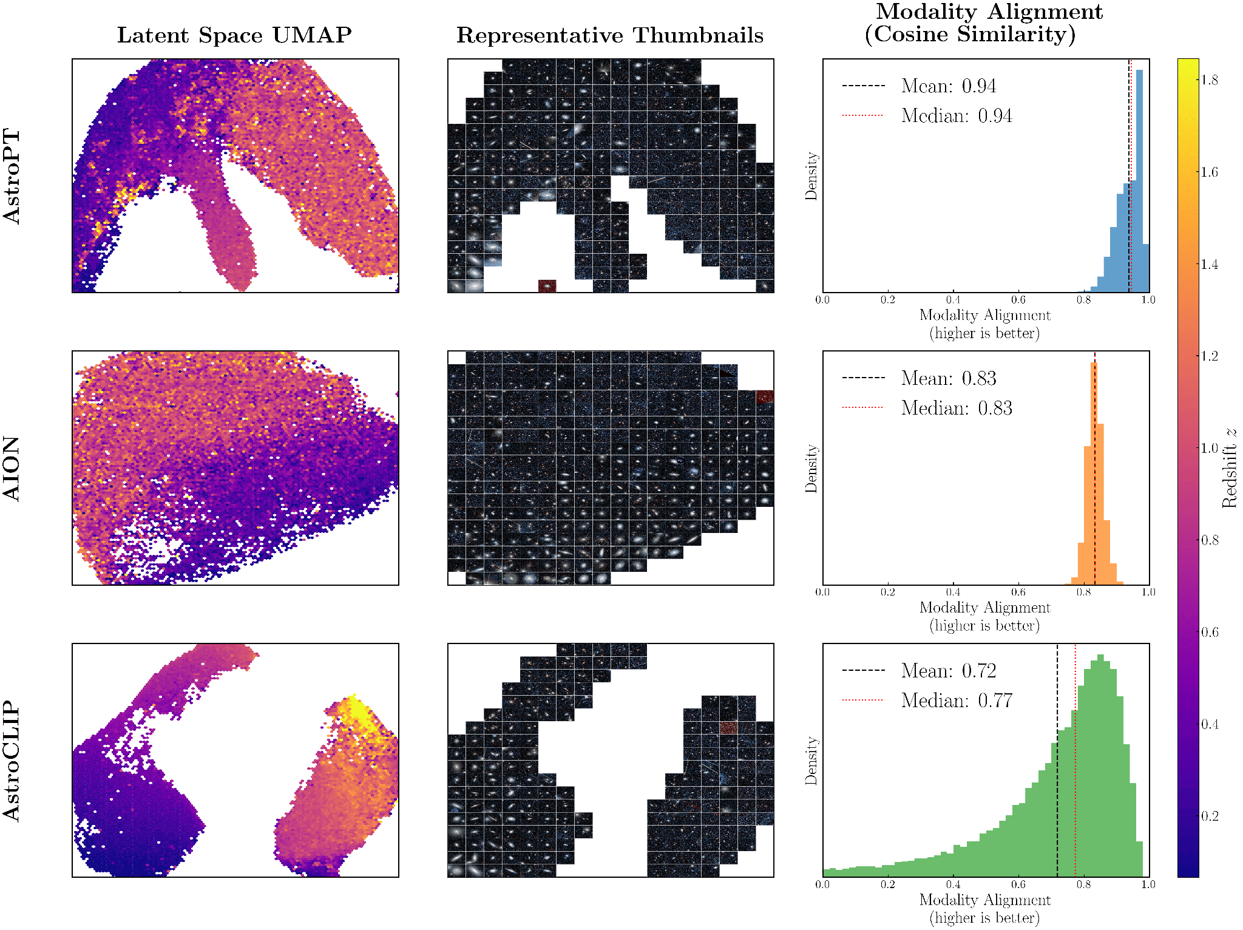
Results
Smooth redshift gradient
Coherent morphological neighborhood
Strong alignment

Slide 26
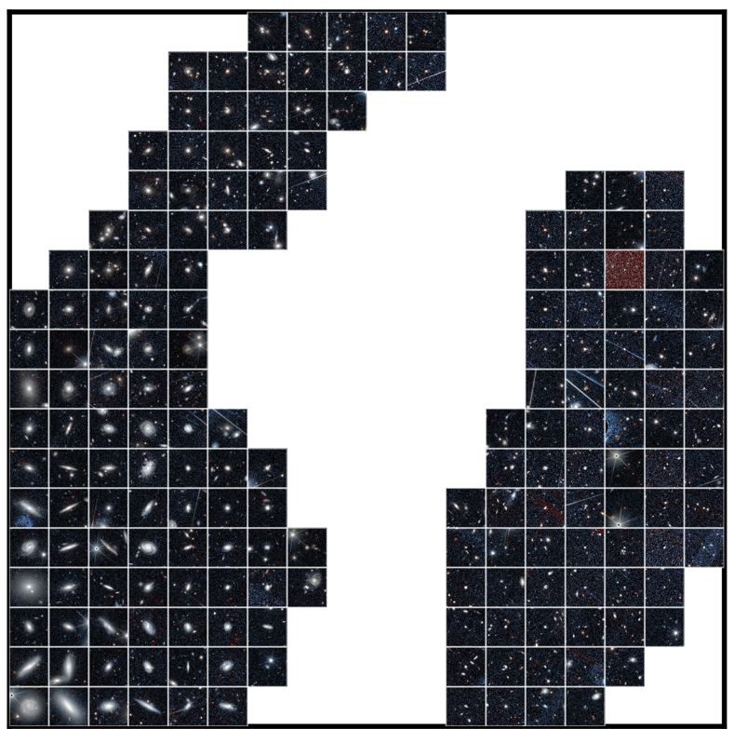
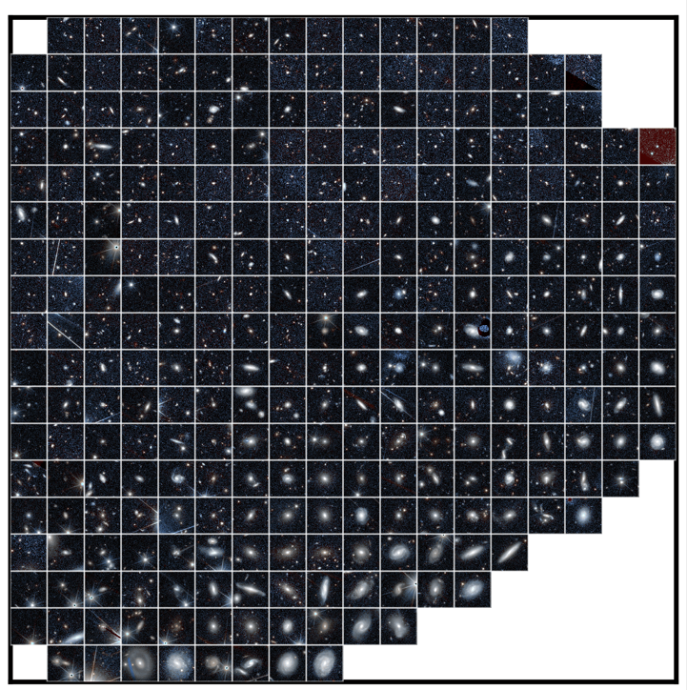
AstroCLIP
Quasars / Hight redshift galaxies
Smooth gradient
Quiescent galaxies
AION

Slide 27


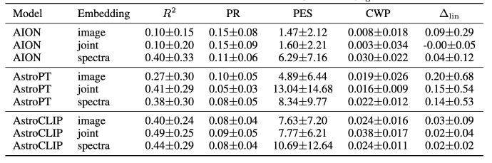
Discussions and Downstream tasks
Spectrum-based embeddings : strongest predictive accuracy
Joint embeddings do not uniformly outperform unimodal ones BUT distribute predictive signal across dimensions
Prediction of relevant physical parameters
from embeddings : Average R², PR , linear gap
Larger linear-to-nonlinear probe gap for AstroPT
⇒ Consistent with literature
contrastive objectives shape embedding geometry in ways that can make simple readouts effective
Likelihood-trained transformer’s embeddings often shows strong anisotropy (Ethayarajh, 2019)

Slide 28
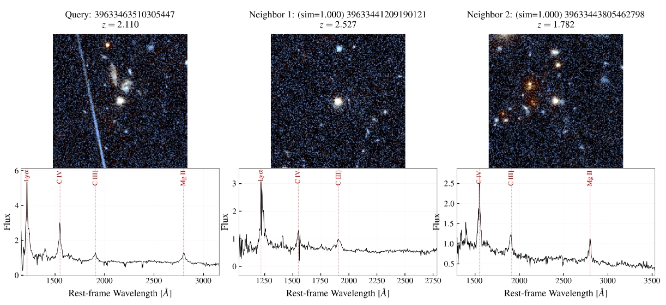
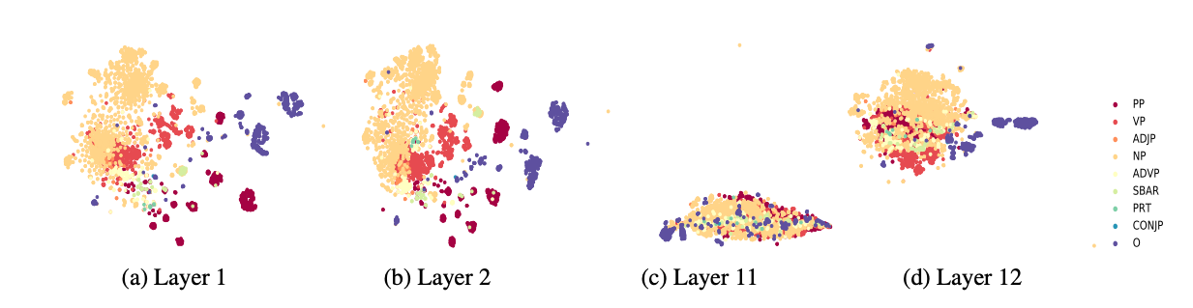
Perspectives & early results
Similarity search
Embedding semantics
  Identify ‘levels’ of information present in the layers (https://inria.hal.science/hal-02131630v1)

Slide 29
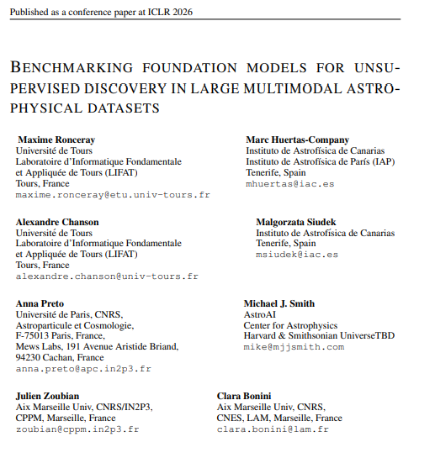

Outreach

Slide 30
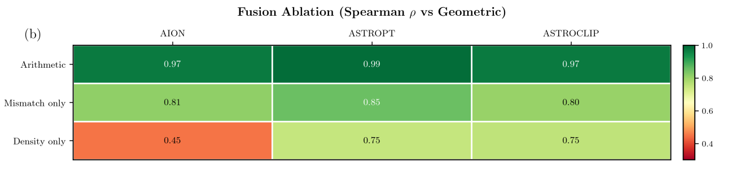
Ablation study

Slide 31
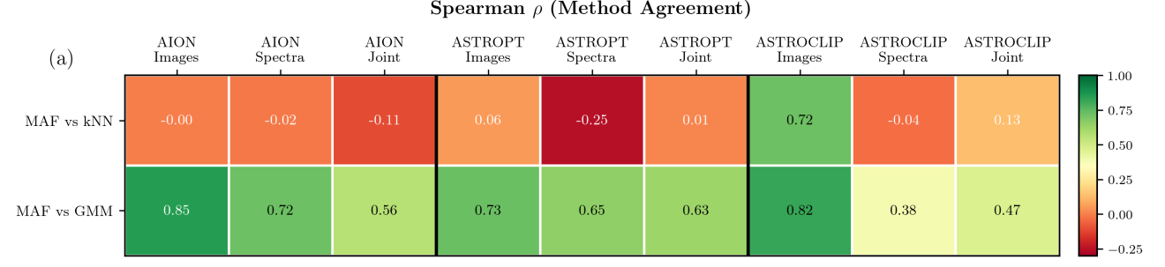
Baseline study

Slide 32
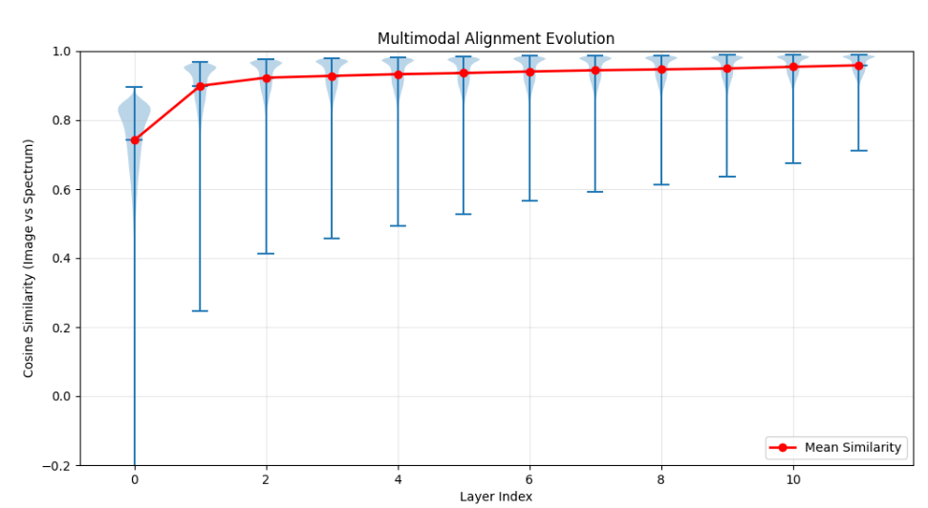
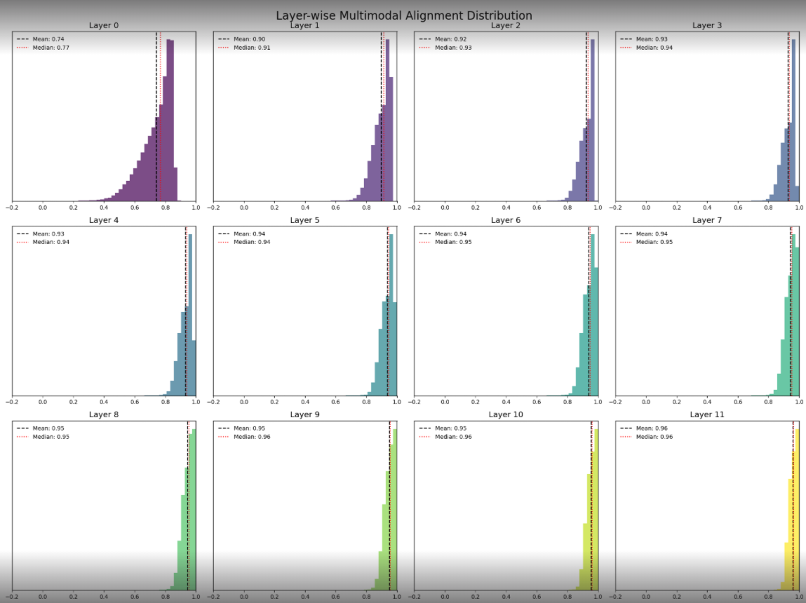
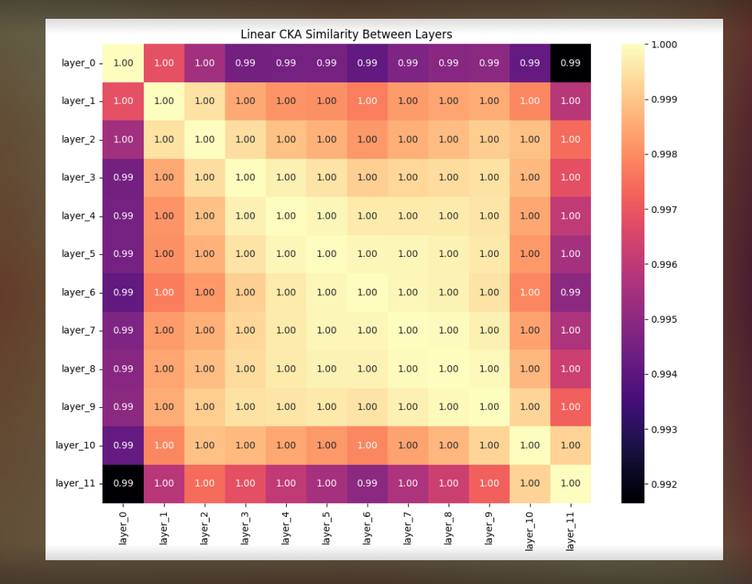
Embedding semantics exploration

Slide 33
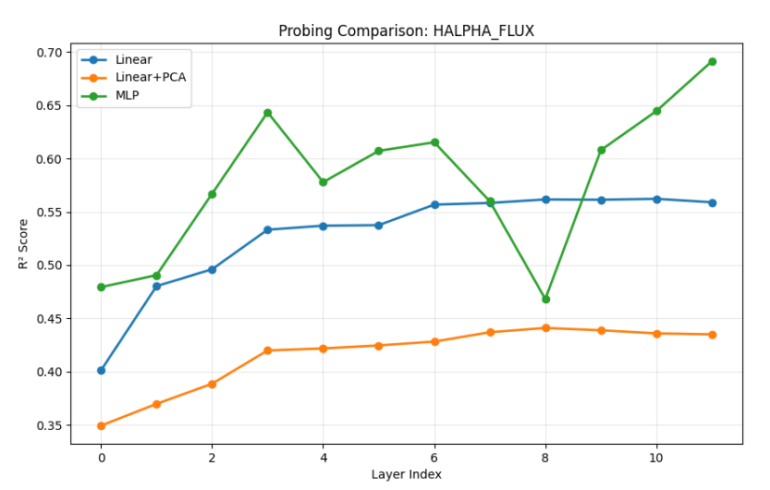
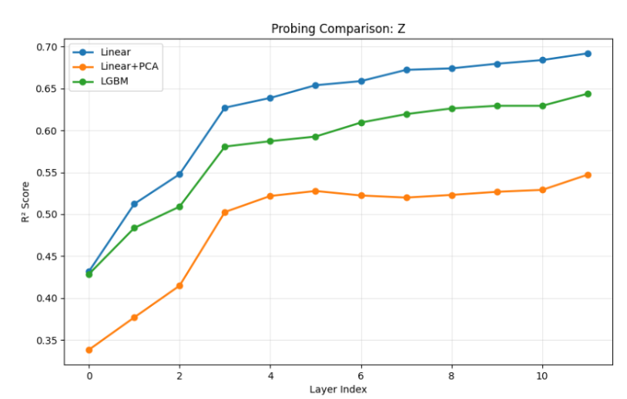
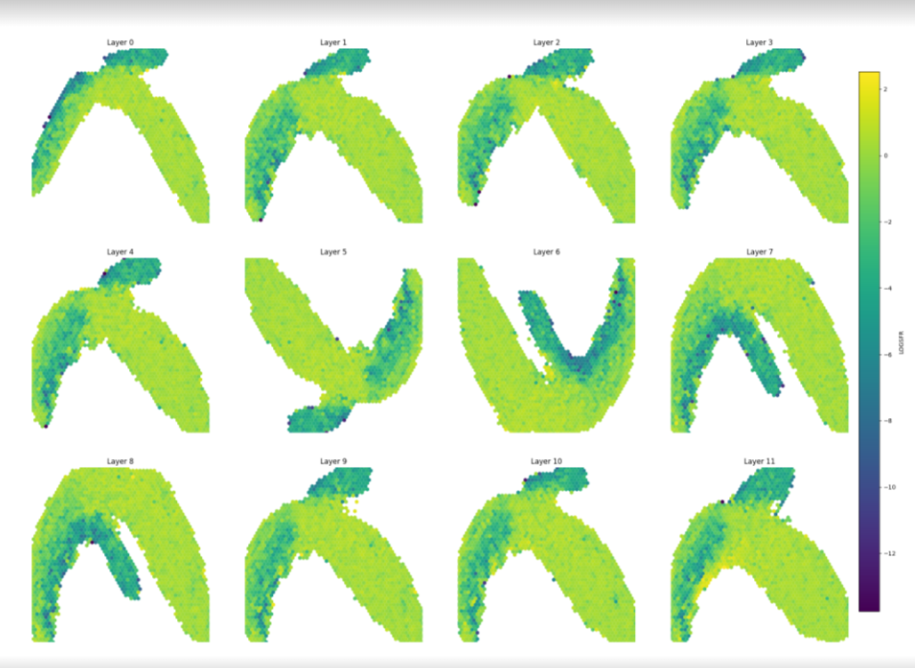
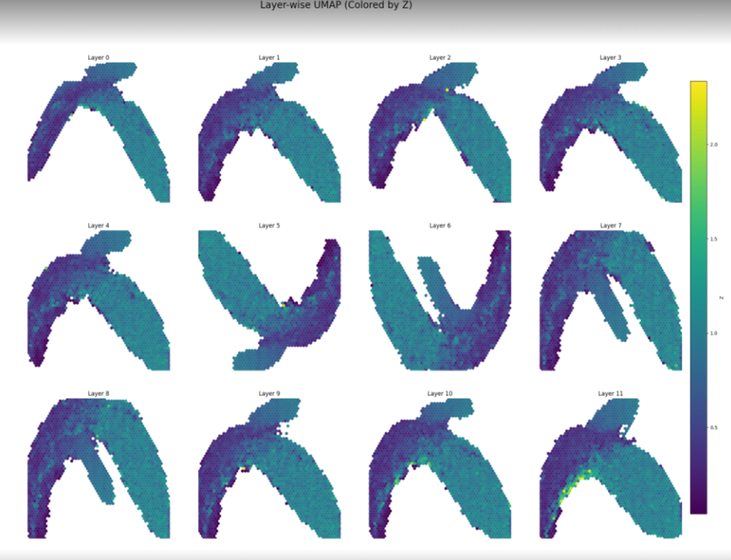
Embedding semantics exploration

Slide 34






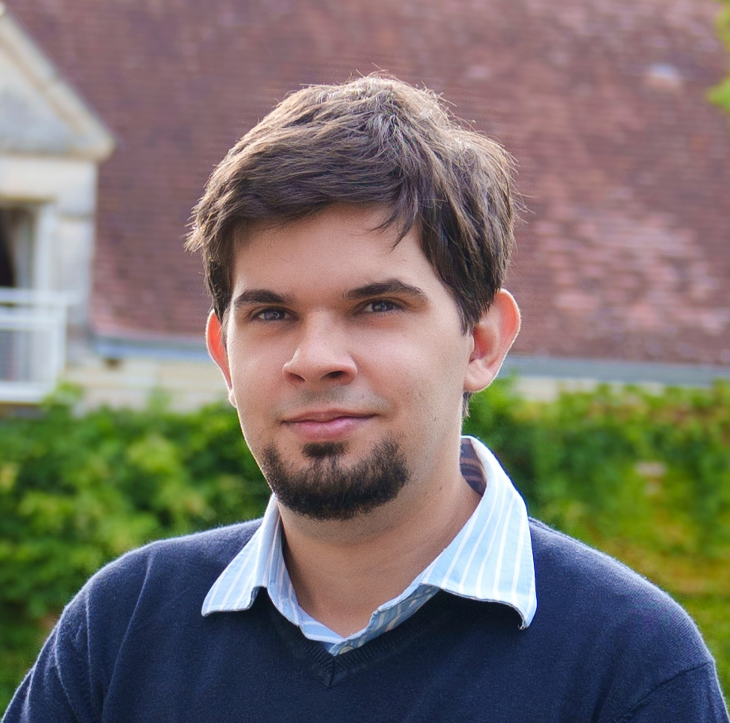

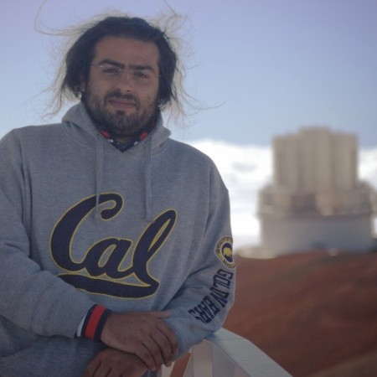
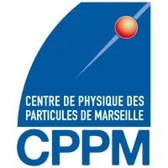






Thank you for listening
Alexandre Chanson
Clara Bonini
Maxime Ronceray
Anna Preto
Julien Zoubian
Marc Huertas-Company
Malgorzata Siudek
Liam Parker
Mike J. Smith

